Slide 1
Software Testing at CMED Health Ltd.
Supervised By:
Dr. Farhana Sarker
Assistant Professor and Course Coordinator
Department of Computer Science and Engineering (CSE)
University of Liberal Arts Bangladesh (ULAB)
Presented By:
Ahanab Haque Akib
ID:161014037
Department of Computer Science and Engineering(CSE)

Slide 2
OUTLINE
Company profile.
Duties and Responsibilities.
Internship Activities
Software testing.
ENRICHed SASTHO.
Corona Module.
Tools used.
Current work & Conclusion.

Slide 3


Company Profile
CMED Health Limited is a startup Health-tech company focusing on preventive healthcare. It was established on 2016. CMED has a smart health monitoring system for regular health monitoring. They uses smart medical sensors connected to a smartphone for measurement of vital signs and store data to its secured cloud server.
The Company has 132263 registered user, 12 client organizations and won 7 major awards.
The vision of CMED is “To create a world where everyone has access to preventive healthcare”.

Slide 4
Company Profile
Company services:
Primary health monitoring
Workforce wellness program (WWP)
Student health & wellness program (SHWP)
Family health & wellness program (FHWP)
Color coded intelligent health status
Cloud based record system
Initial health consultation
Result based suggestion
CMED app customization service
CMED e-prescription

Slide 5
Duties and Responsibilities.
Software testing of “ENRICHed SASTHO” mobile/web application. It is a project of Palli Karma-Sahayak Foundation (PKSF), Bangladesh.
Software testing of “Corona Module” mobile and web application.
Testing For data mismatch between swagger API, mobile and web applications.
Providing necessary IT support.

Slide 6
Internship Activities
Wrote basic test cases for testing and tested basic functionalities according to test cases.
Tested mobile and web application of “ENRICHed SASTHO” in depth for system bug.
Tested “Corona Module” in multiple mobile and web application.
Tested for design mismatch and worked closely with Design and Front-end developer team.
Tested for data mismatch between Mobile application ,Web dashboard and Swagger API’s. Worked with Backend developer team for this.
Provided support in testing for multiple projects including CMED Corporate, Tottho Apa , Help Age, CMED user app and web dashboard.

Slide 7
Software testing
Software testing is the process of evaluation a software item to detect differences between given input and expected output. There are two basics of software testing: Black box testing and White box testing.
Black box testing is a testing technique that ignores the internal mechanism of the system and focuses on the output generated against any input and execution of the system. It is also called functional testing.
White box testing is a testing technique that takes into account the internal mechanism of a system. It is also called structural testing and glass box testing.

Slide 8
Software testing
There are many types of testing like : Unit Testing , Integration Testing, Functional Testing , System Testing , Stress Testing, Performance Testing, Usability Testing, Acceptance Testing, Regression Testing, Beta Testing.
In my assigned projects, I have been using User Acceptance testing mostly.
User Acceptance testing is often done by the customer to ensure that the delivered product meets the requirements and works as the customer expected. It falls under the class of black box testing.

Slide 9
ENRICHed SASTHO
The Palli Karma Sahayak Foundation(PKSF) , It’s 52 partner organization, 51 coordinator, 94 health officers and 633 health visitors came together to take part in ENRICHed SASTHO project. This project is going to help take the necessary health measurements and collect survey in the rural areas of Bangladesh. Total 1086 villages in Bangladesh will be served under this project.
ENRICHed SASTHO project helps taking necessary health measurements of blood pressure, glucose, temperature, oxygen saturation, BMI from each household member. Also the project will collect survey data on some necessary elements like if the household has access to safe water, sanitary latrine, electricity etc. With the collective data on the number of sick people of an area, this project can help the government focus on what type of medicine and healthcare is necessary in which area.

Slide 10
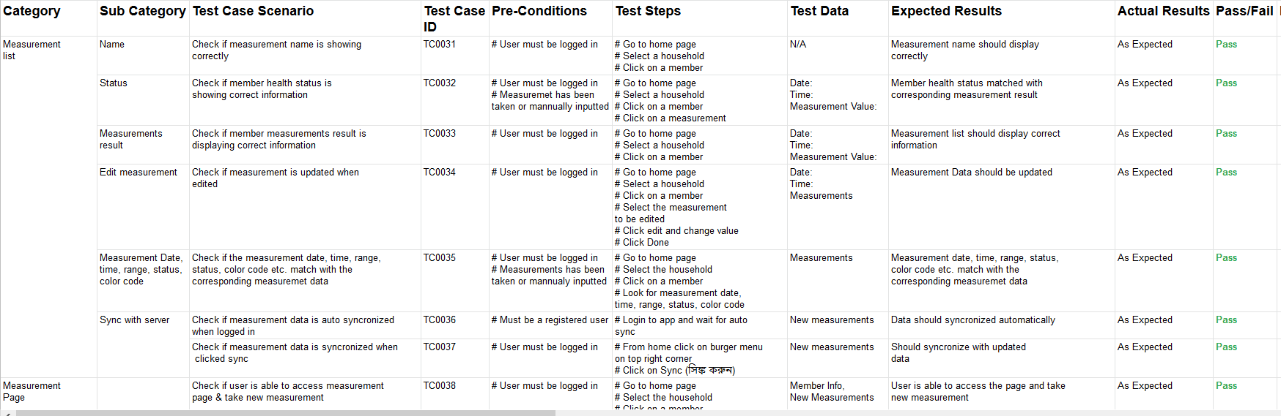
Test cases written for “ENRICHed SASTHO” measurement testing

Slide 11
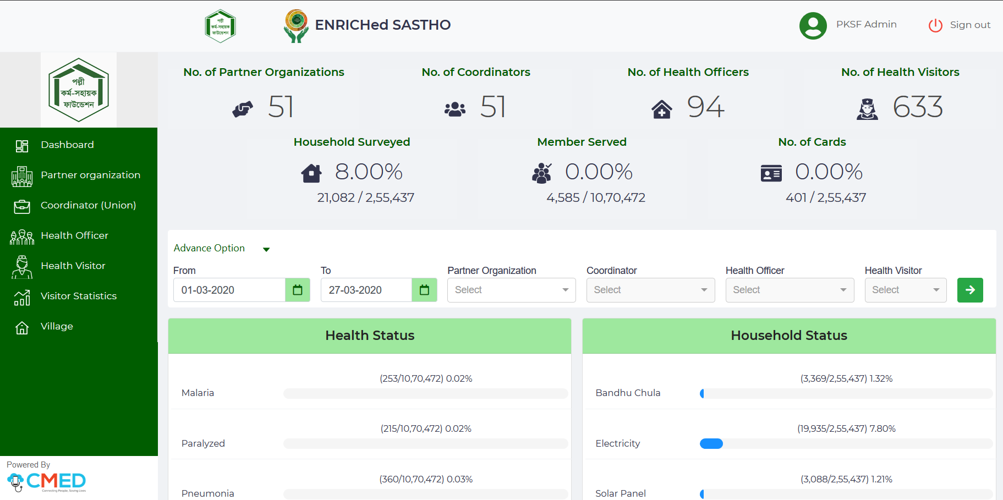
“ENRICHed SASTHO” Web dashboard

Slide 12
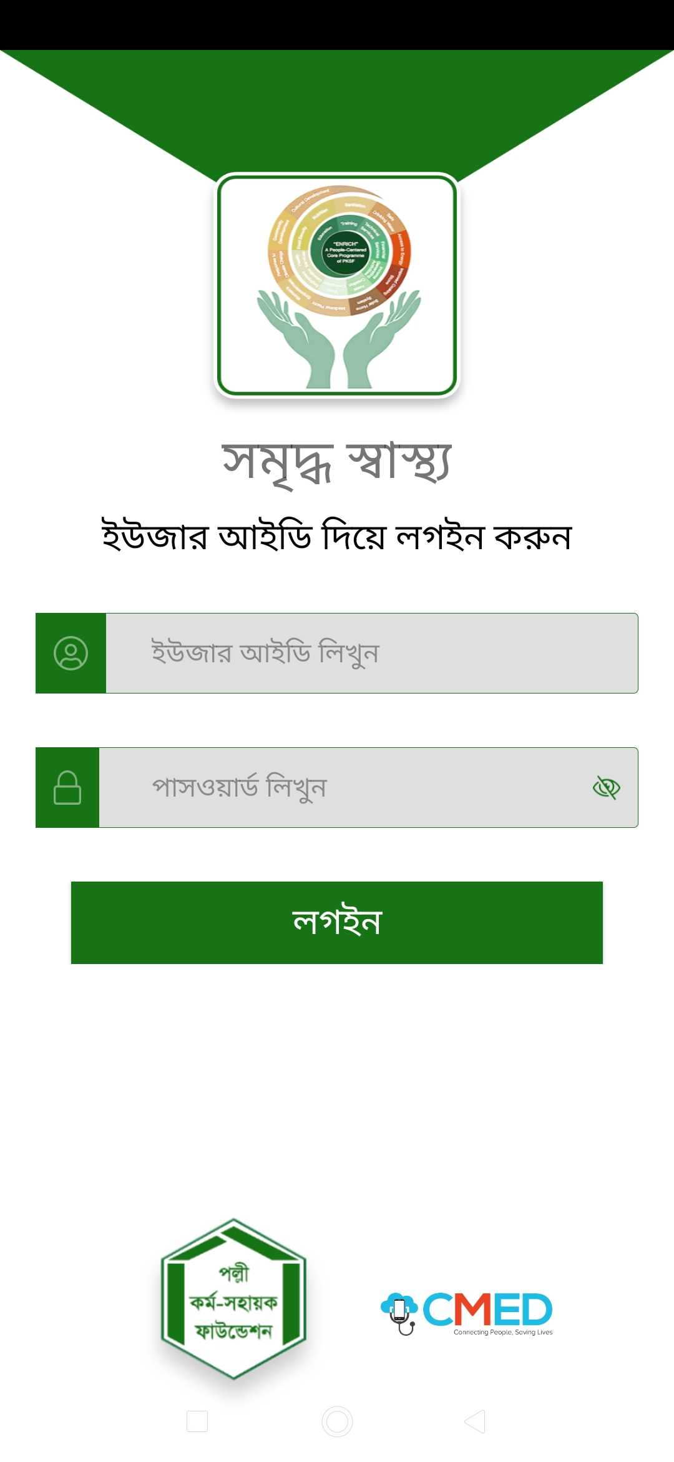
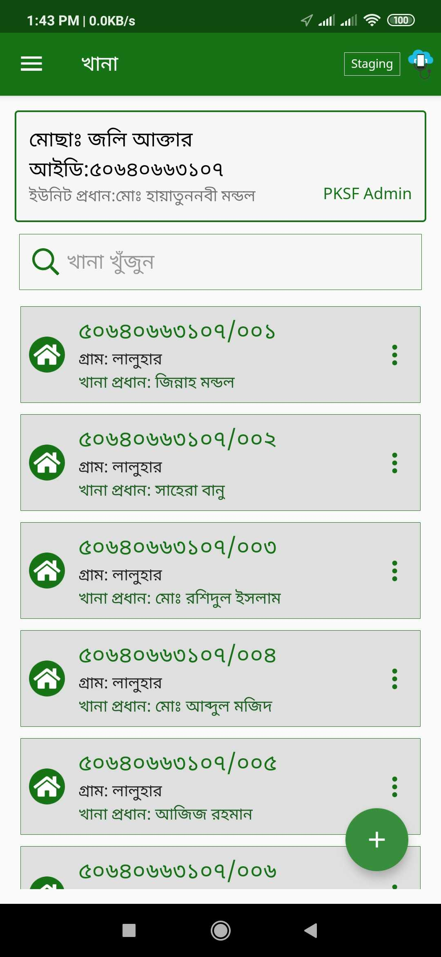

“ENRICHed SASTHO”
Mobile Application

Slide 13
Corona Module
Currently the world is suffering from corona epidemic. Coronaviruses are a family of viruses known for containing strains that cause potentially deadly diseases in mammals and birds. In humans they're typically spread via airborne droplets of fluid produced by infected individuals.
Just when the corona virus started spreading in Bangladesh, with the support of the Bangladesh Government and IEDCR, CMED started working on a module to add on their existing applications. CMED currently has 132263 registered user for their health applications. This corona module could help these user a lot. This module includes an informative part for the users and an for the health officers, an online screening part where the user can answer a few questions and the app will let them know if they are in risk or not, an emergency contact section and a unique web dashboard to monitor over the situation.

Slide 14
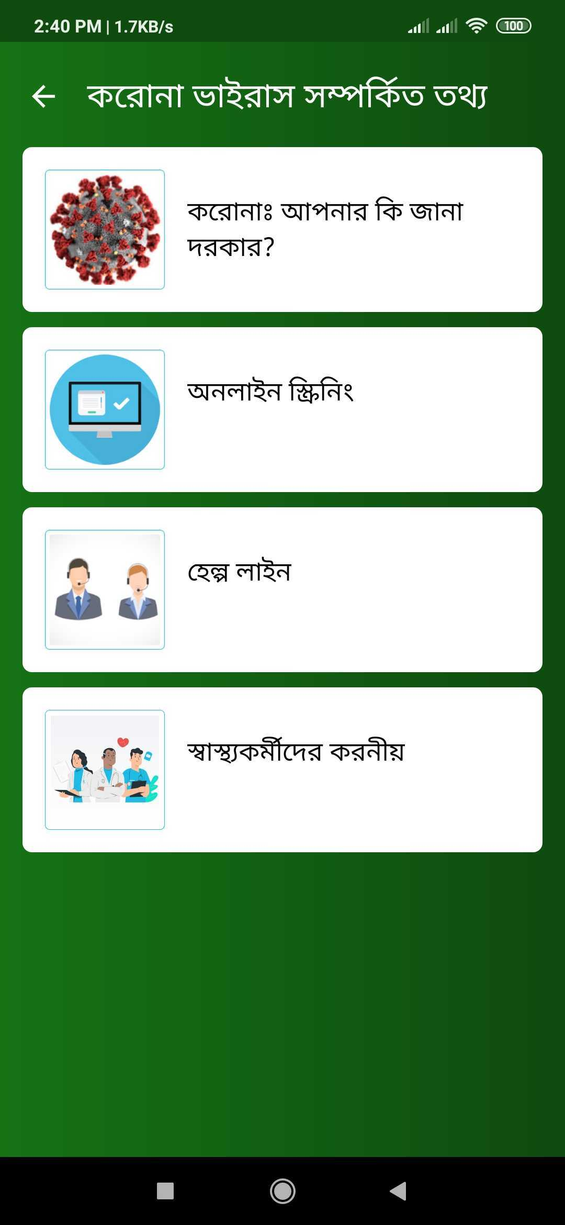
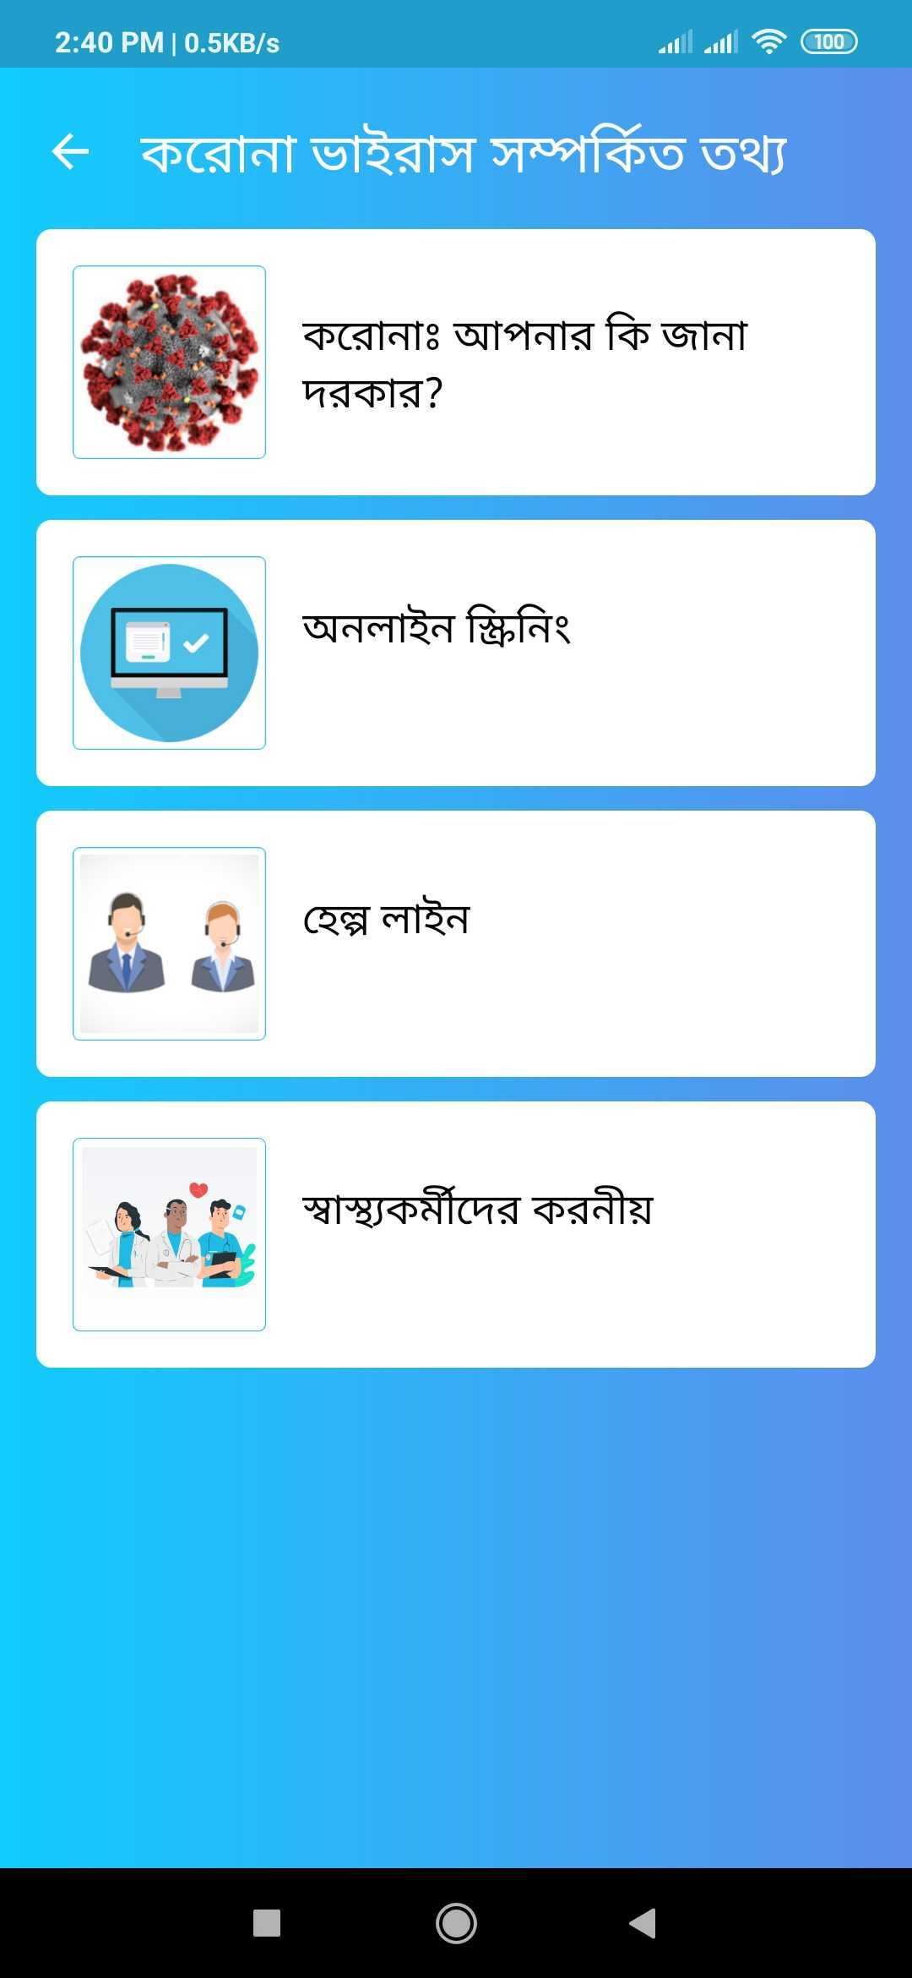
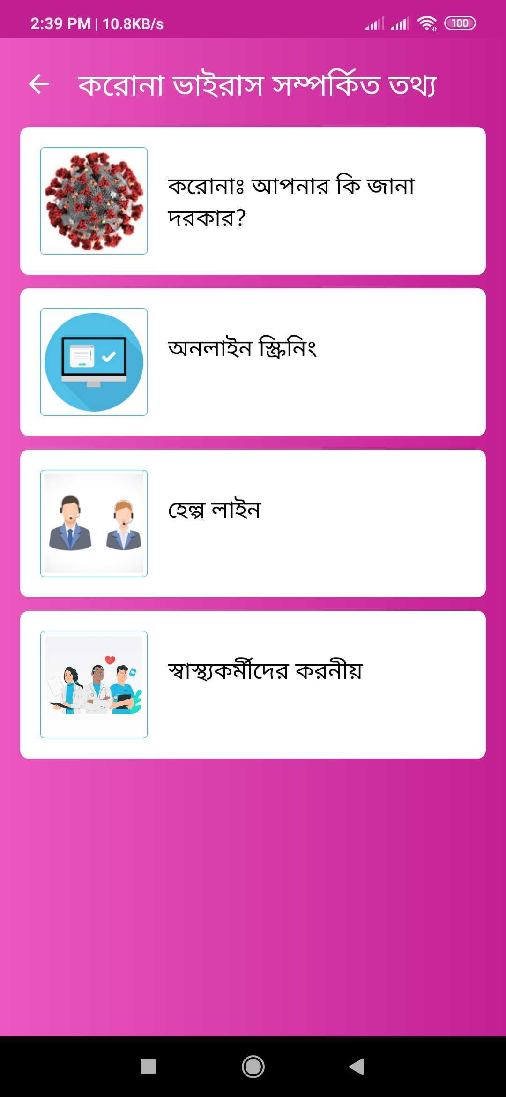
Corona Module in different Application

Slide 15
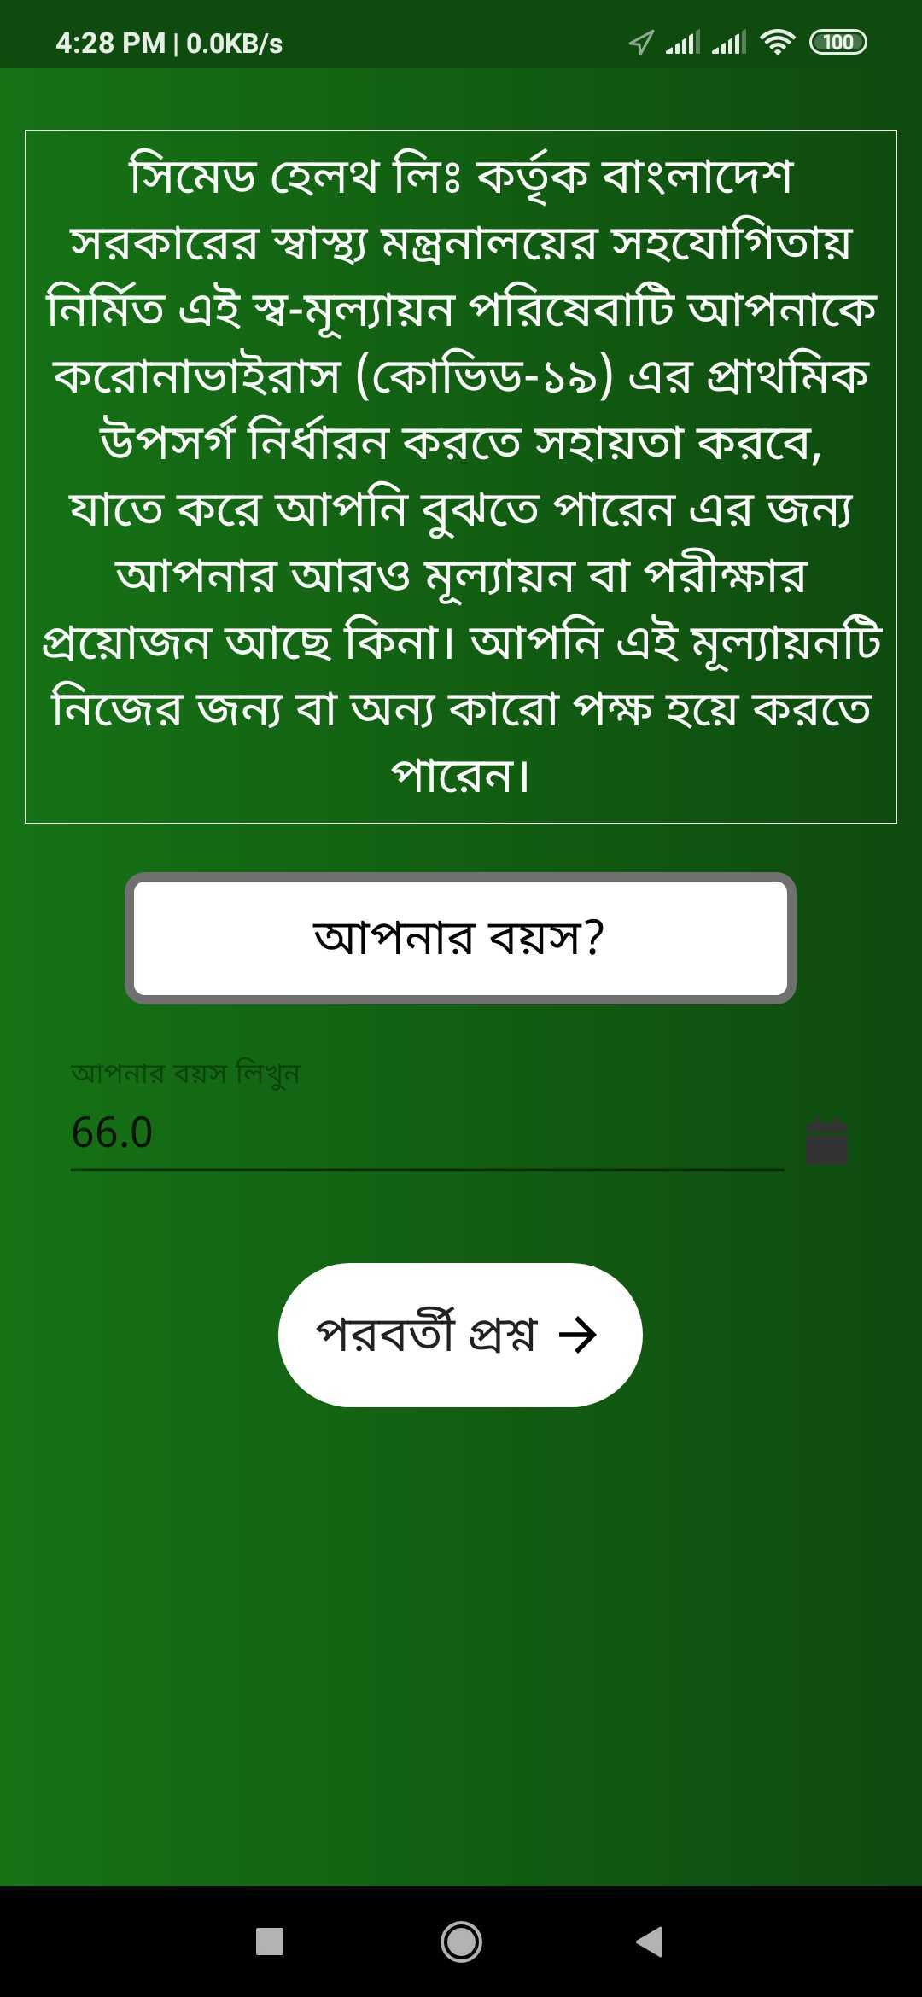
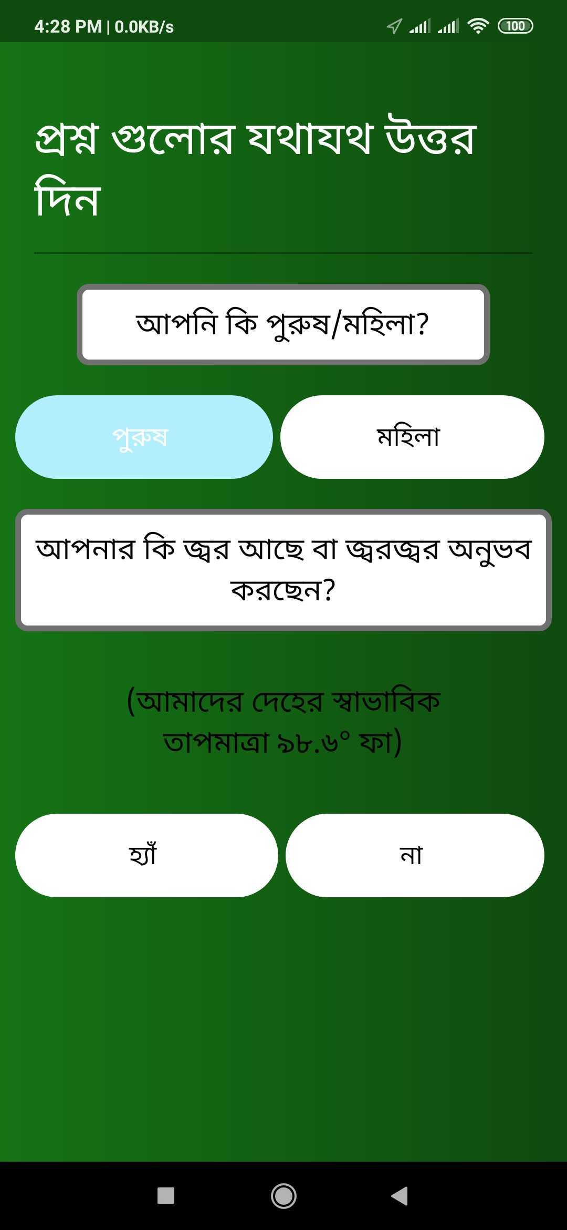
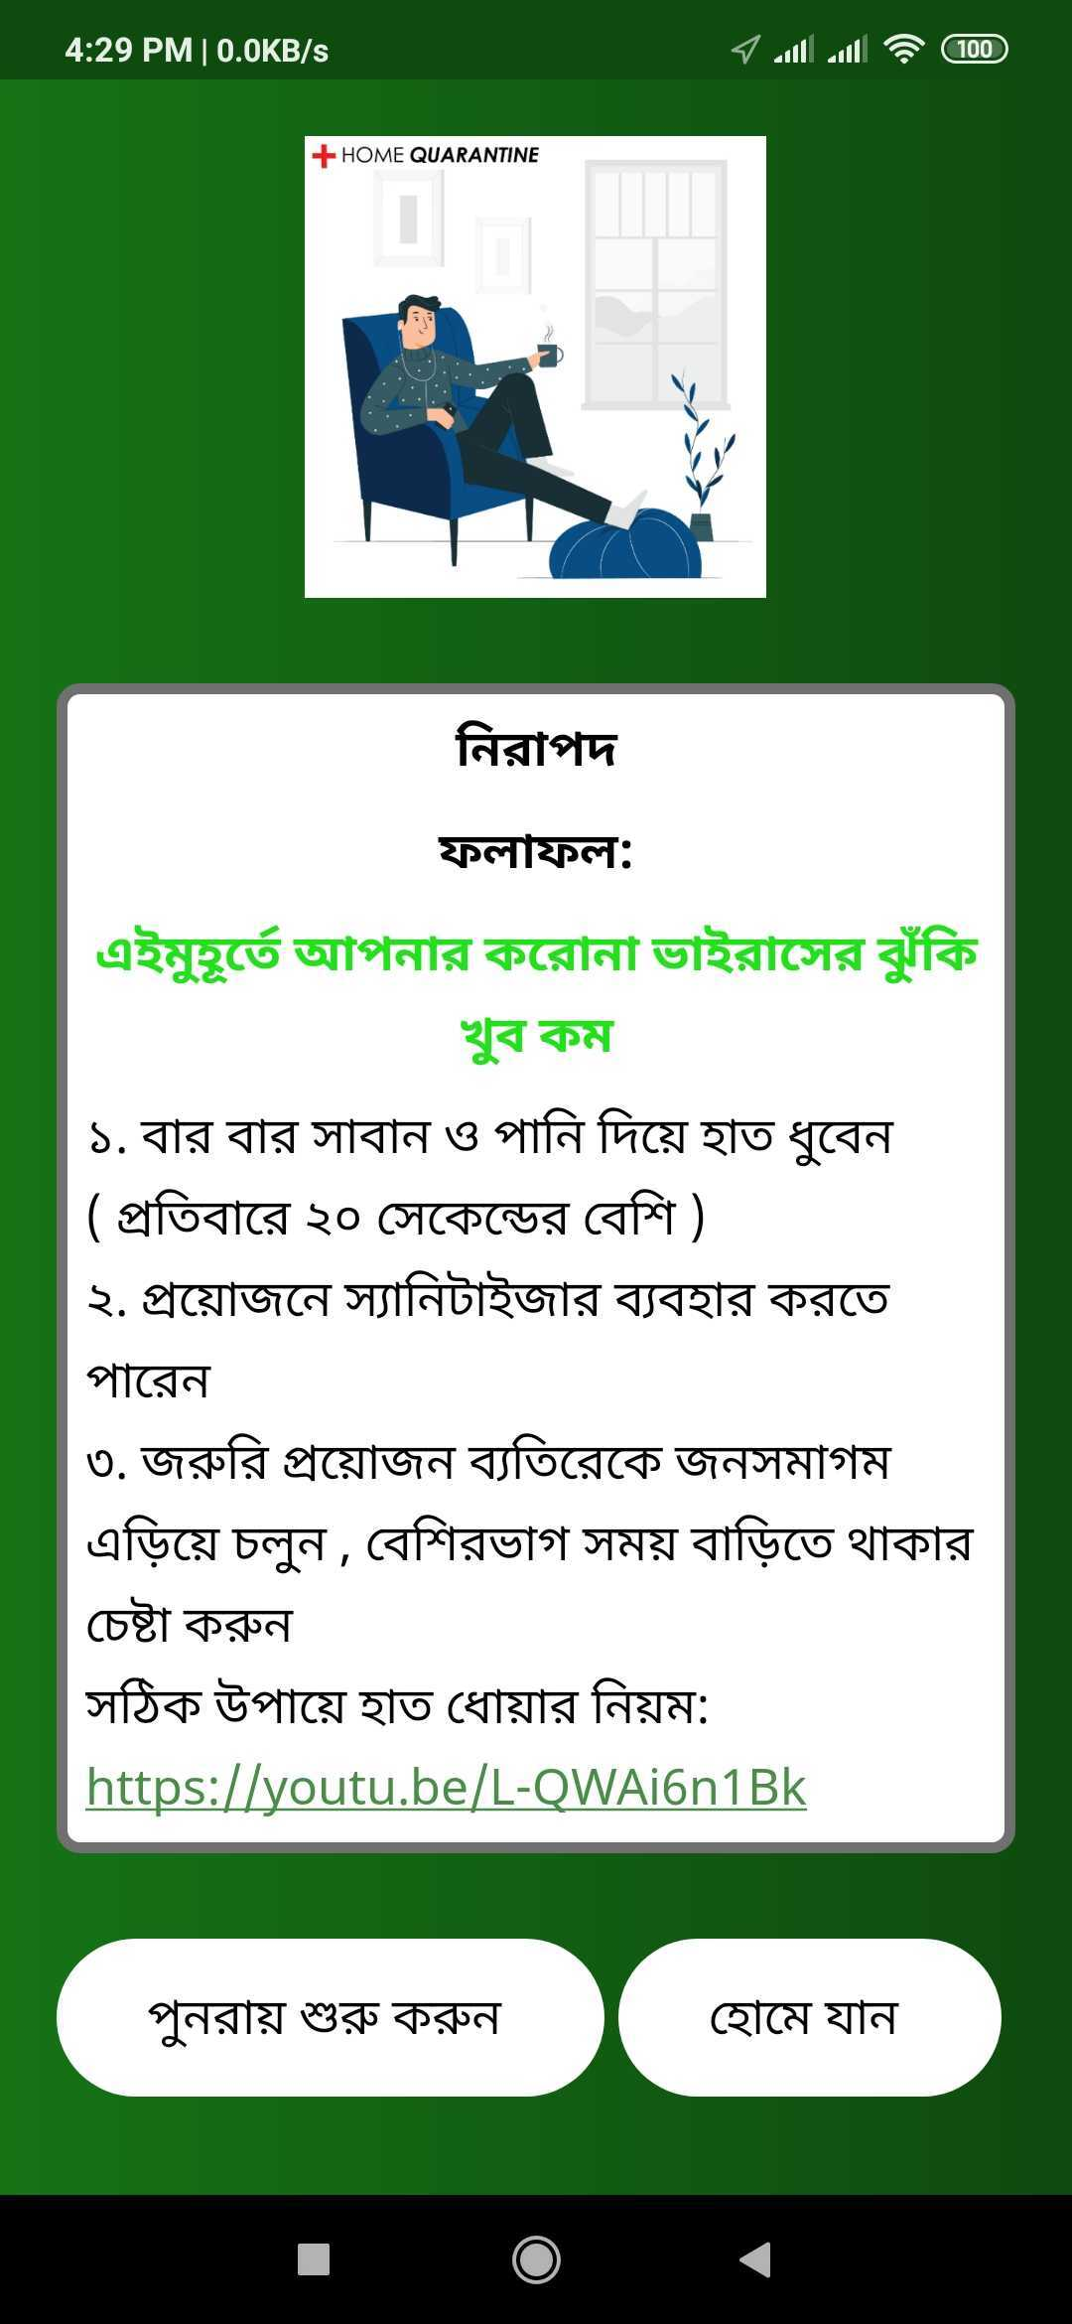
Online Screening sample question and result

Slide 16
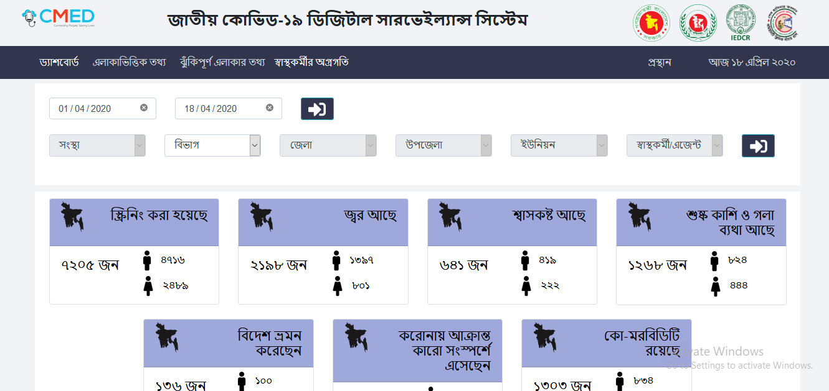
Corona module web dashboard

Slide 17
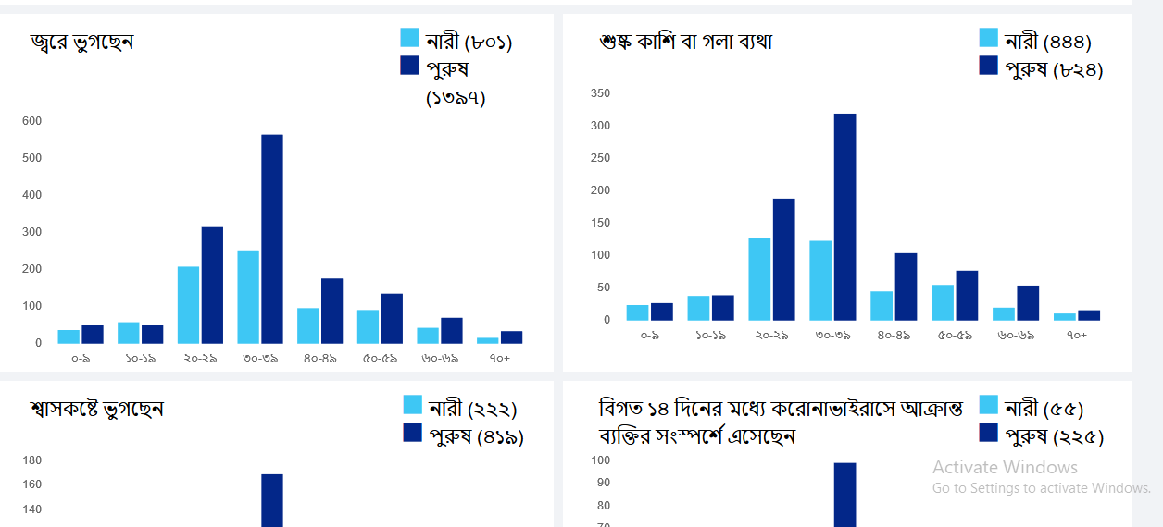

Slide 18
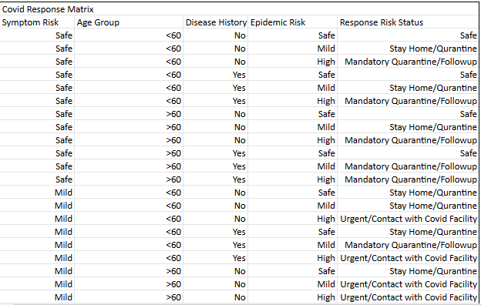
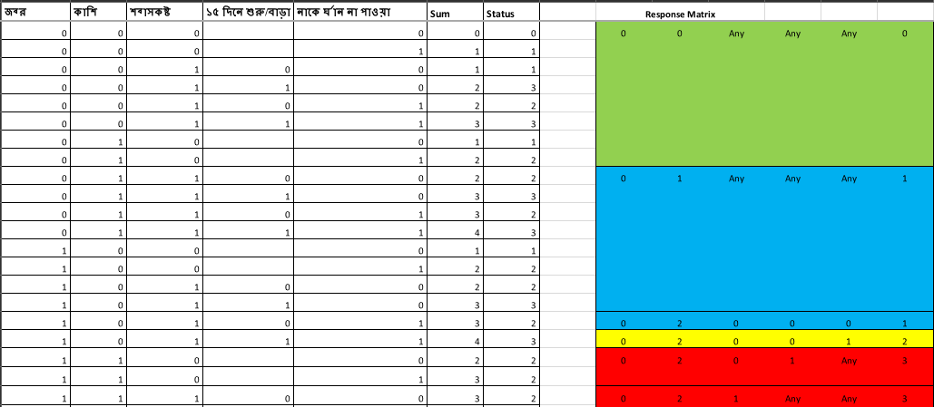
Expected response sample from online screening

Slide 19
Tools Used
CMED Measurement devices: CMED has multiple smart devices for health check up. Had to learn how to use those as major part of our testing depends on those measurement devices.
Slack: Used slack for Communication, Daily target announcement, Check in/Check out messages.
Redmine: Redmine is the management software used in CMED. We can assign a issue to developer team after finding and developer team can assign the issue to testing team after it’s solved. Used redmine to inform about the issues found, tracked the currently in progress features, tested the already fixed issues.
Trello: Uploaded issues found in application to trello.
Swagger : CMED uses swagger framework to design API’s. Had to learn how to test data and call a certain API in swagger.

Slide 20
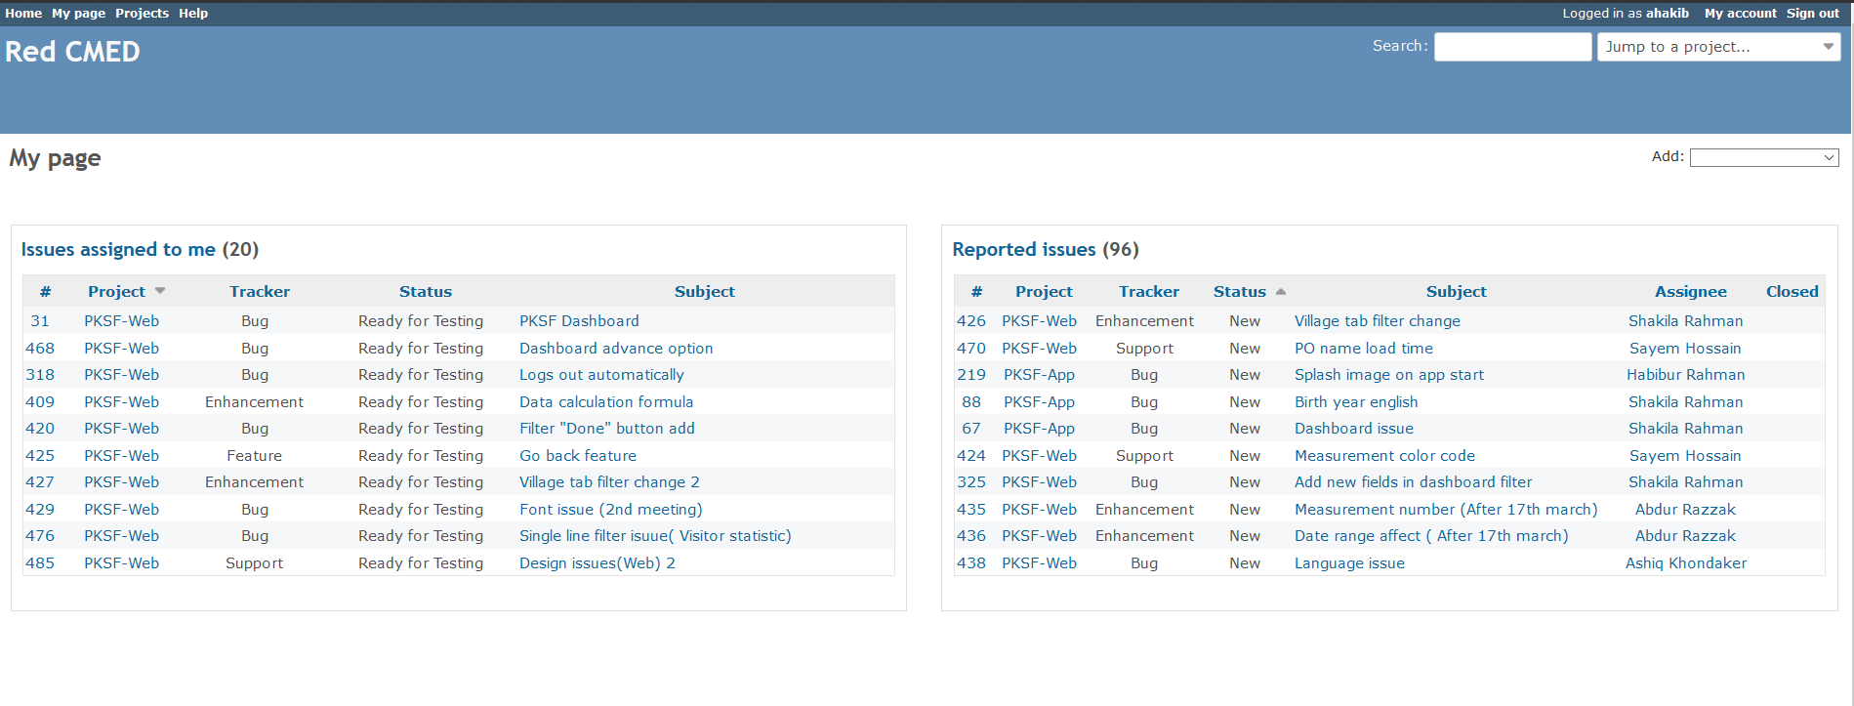
Redmine Management Software

Slide 21
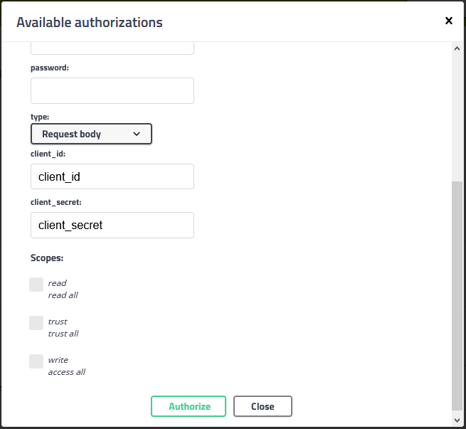
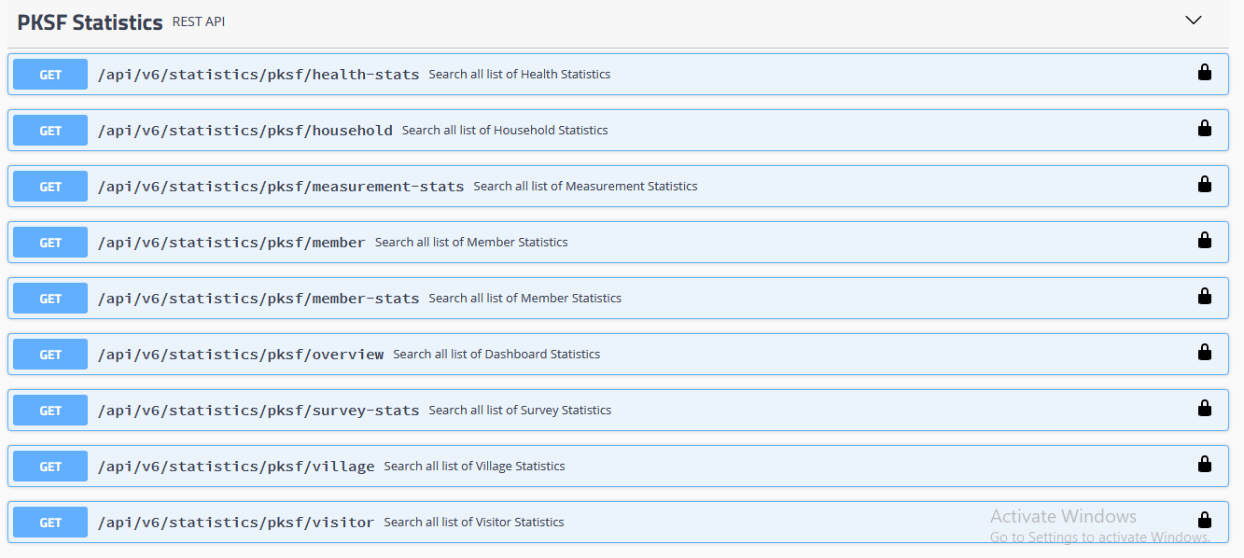
Swagger Authorization page and API example

Slide 22
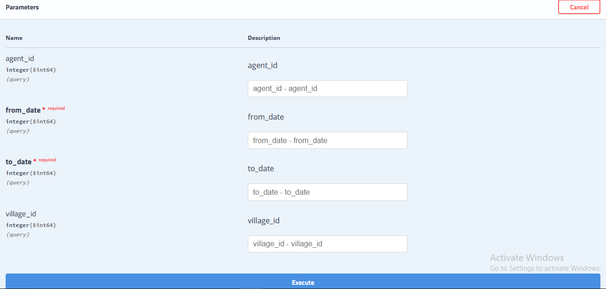
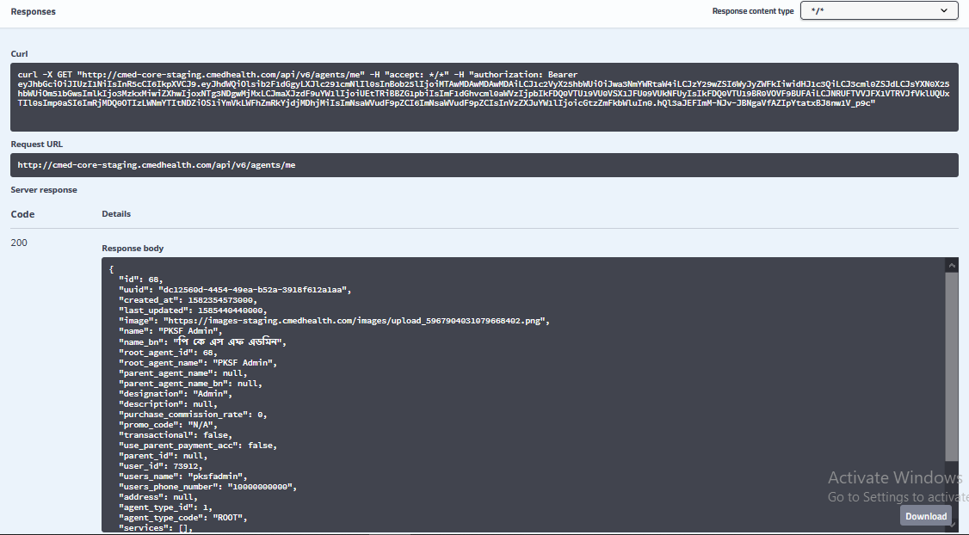
Swagger API parameters to execute and API response example

Slide 23
Current Work
Currently Directorate General of Health Services (DGHS) and BRAC are working together on a project that would help them to work as a center point of helpline in this Corona pandemic situation.
CMED Health Ltd is helping them by creating the mobile application and a web dashboard for this project.

Slide 24
Current Work
The project includes:
An online screening system to determine the risk of corona,
Allows Area Manager and Health workers to call and collect sample from the patients with high risk of Corona.
Collecting Different types of sample to determine corona and sending them to specific laboratory for testing.
Receiving and sending the test result to the client/patient.
A web dashboard for Area Managers to track their Health officers progress and a view of overall status.

Slide 25
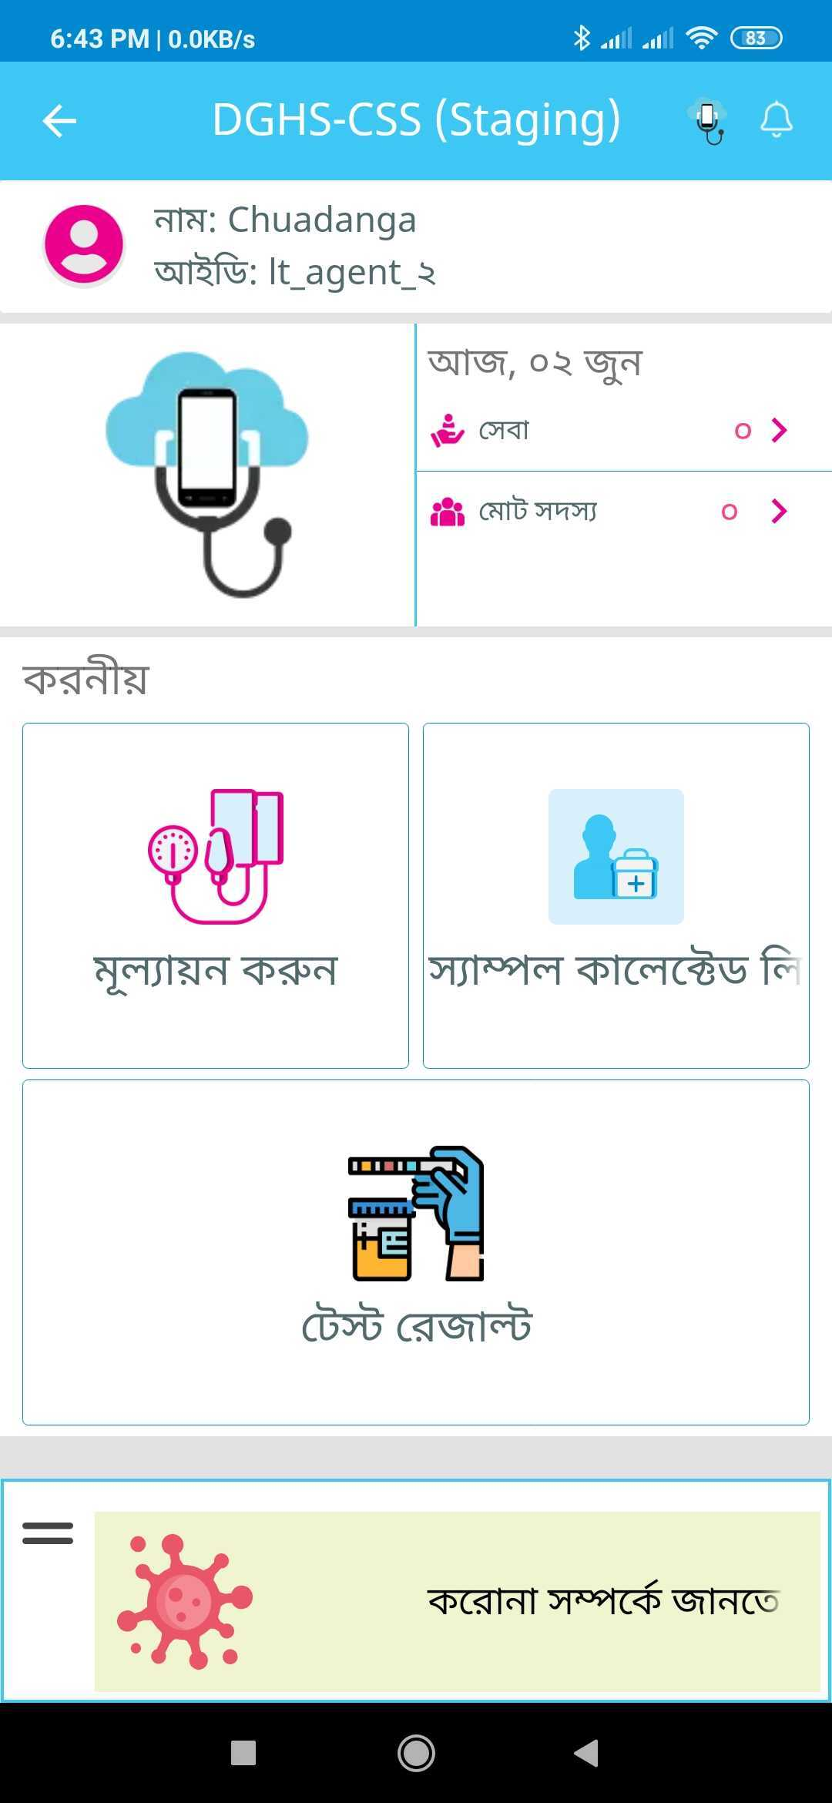
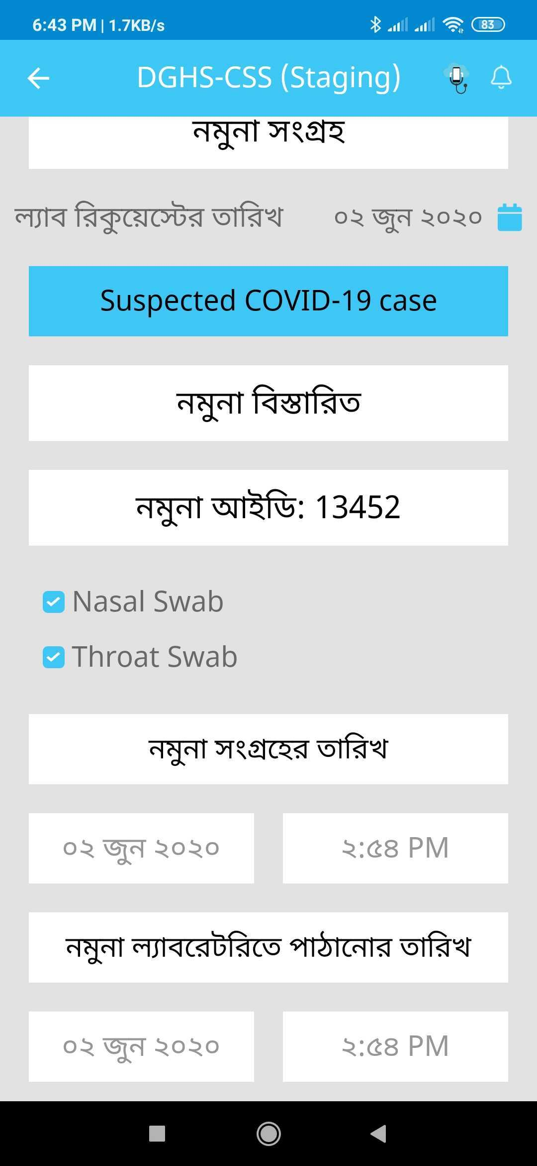
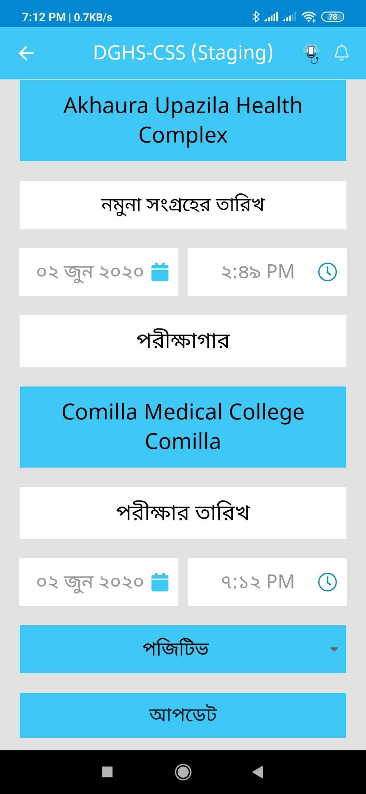
Current Work

Slide 26
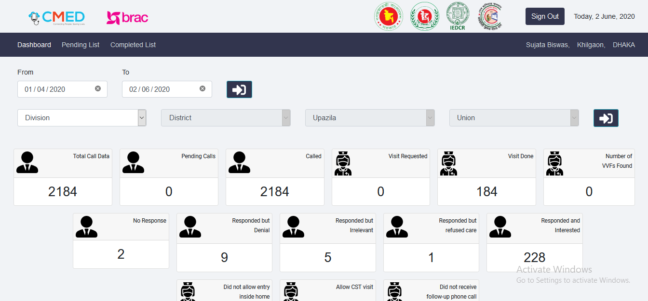
Current Work

Slide 27
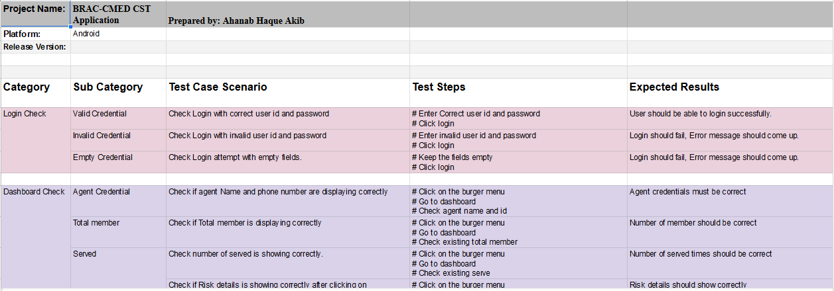
Current Work

Slide 28
Thank You

